Slide 1
A Web Crawler for UBike Dataset
0856706 Susan Ku

Slide 2
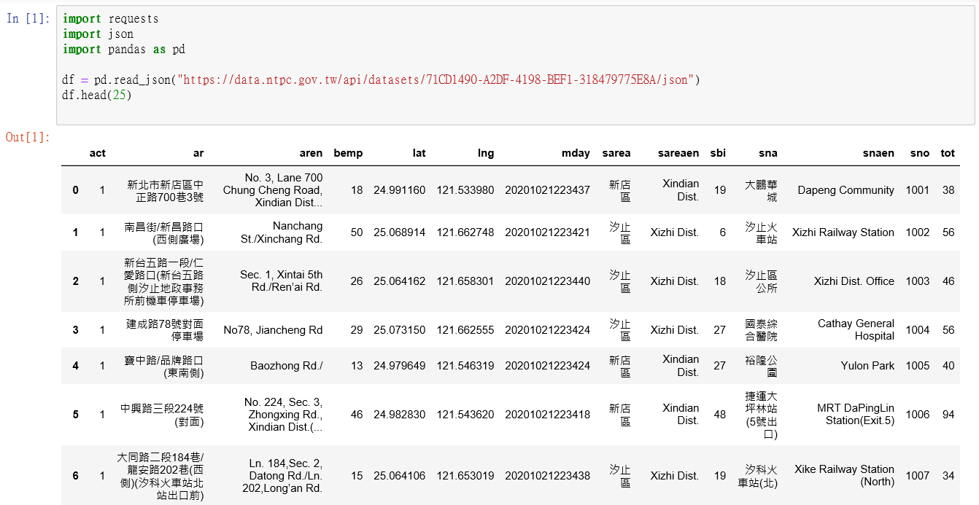
Web Crawling
Use pandas DataFrame to visualize data crawled from website

Slide 3
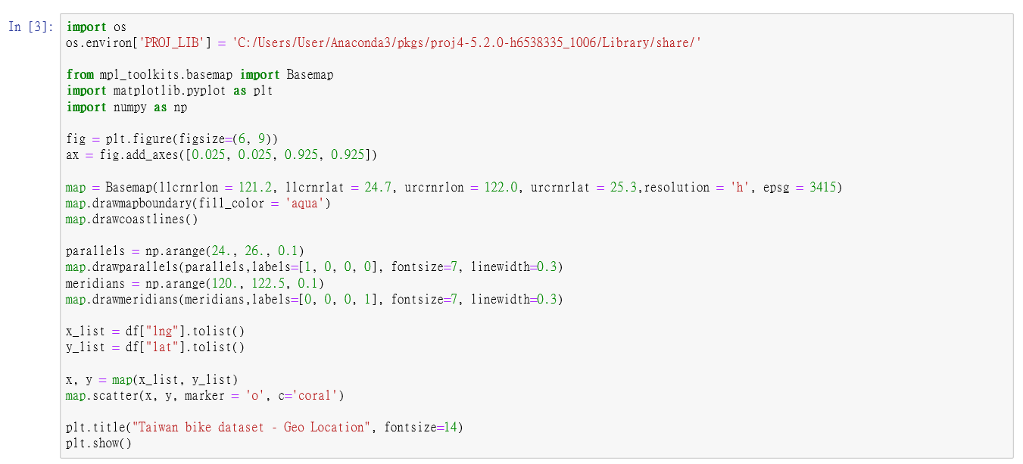
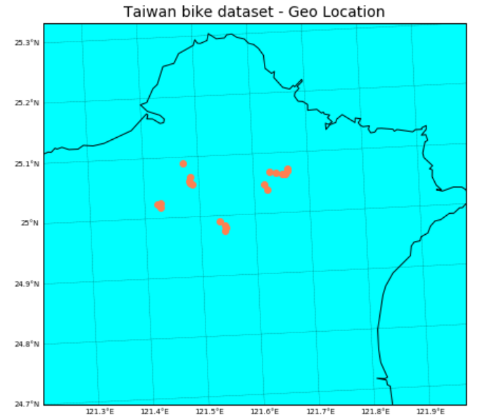
Scatter Plots (1)
Use Basemap toolkit to show GeoInfo map

Slide 4
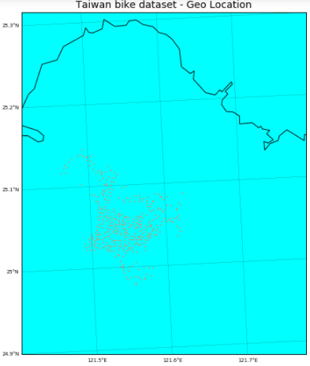
Scatter Plots (2)
Read another open data from:
https://tcgbusfs.blob.core.windows.net/blobyoubike/YouBikeTP.json

